Slide 1
Introduction to Graphs
GRAPH ALGORITHMS

Slide 2
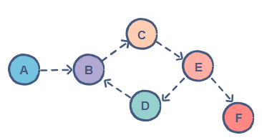
Algorithms
“A directed graph (or digraph) G consists of a set of V (vertices/nodes)
and a set of E (edges) called arcs such that each edge/arc is
associated with an ordered pair of vertices”
Directed edges are called ARCS
An arc has a tail and a head
e(a,b), e = ab;
a = start vertex or tail,
b = end vertex or head
Two edges ab and ba are called anti-parallel edges.
In digraph an edge is not only incident on a vertex but it is also incident out of vertex and incident into a vertex
The vertex v_{i}, edge e_{k} is incident out is called initial vertex of e_{k}
The vertex v_{i}, edge e_{k} is incident into is called terminal vertex of e_{k}
Edges for which initial and terminal vertices are same form a self loop

Slide 3
Algorithms
The number of edges incident out of a vertex v_{i} is called Out Degree (out valence) of v_{i}
It is written as d⁺ (v_{i})
The number of edges incident into of a vertex v_{i} is called In Degree (in valence) of v_{i}
It is written as d⁻ (v_{i})

Slide 4
Algorithms
ISOLATED VERTEX is a vertex in which the in-degree & out-degree are both equal to 0.
A vertex v in a digraph is called pendant if it is of degree 1.
D⁺(v) + D⁻(v) = 1
Undirected graph obtained from G (directed graph) will be called undirected graph corresponding to G
An undirected graph H, each edge of H is assigned some arbitrary direction, resulting a digraph, H’ is called an orientation of H and graph is called digraph associated with H

Slide 5
Algorithms
ISOMORPHIC DIGRAPHS:
Two graphs G₁ and G₂ are said to be isomorphic if
Their number of components (vertices and edges) are same
Their edge connectivity is retained
If G₁ ≡ G₂ then
|V(G₁)| = |V(G₂)|
|E(G₁)| = |E(G₂)|
The directions of corresponding edges must be same
SIMPLE GRAPH:
A digraph that has no self loop or parallel edges is called simple digraph

Slide 6
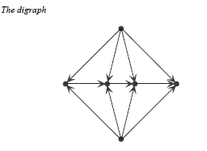
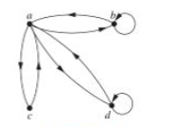
Algorithms
ASYMMETRIC DIGRAPH:
A digraph that have at most one directed edge between a pair of vertices but are allowed to have self-loops.
SYMMETRIC DIGRAPH:
Digraph in which every edge (a,b) there is also an edge (b,a)

Slide 7
Algorithms
COMPLETE DIGRAPH:
For digraphs, there are 2 types:
Complete Symmetric Digraphs:
A simple digraph in which there is exactly one edge from every vertex to every other vertex of graph.
Complete ASymmetric Digraphs:
A graph in which there is exactly one edge between every pair of vertices.
A digraph is called a balanced if for every vertex v_{i} the in-degree equals to the out-degree
D⁺(v_{i}) = D⁻(v_{i})
A balanced digraph is also referred to as a pseudosymmetry digraph or isograph

Slide 8
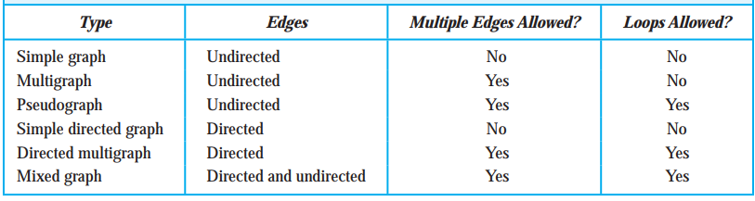
Graph Terminologies - Summary

